Slide 1










Skye Yang Period 3
A Midsummer Night’s Dream
Slide Presentation

Slide 2
How to Use This
Presentation
Viewing on Slideshow is HIGHLY RECOMMENDED
Google Slides
Click on the "Google Slides" button below this presentation preview.

Slide 3
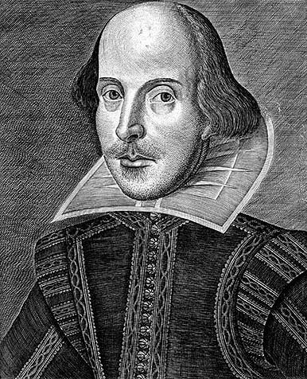
William Shakespeare
William Shakespeare is the popular English playwright poet from the late 1500s to early 1600s. He wrote many plays, the one that’ll be discussed is A Midsummer Night’s Dream

Slide 4



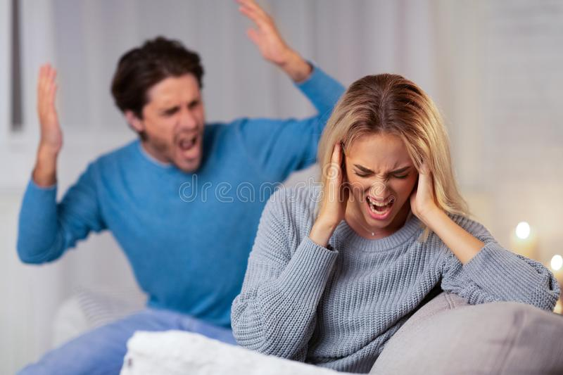
A Midsummer Night’s Dream
In summary, A Midsummer Night’s Dream tells the story of many lovers with the main four lovers being Lysander, Hermia, Helena, and Demetrius. The love in all four characters becomes very complicated causing many conflicts in the story.
The play was premiered in 1605 being a memorable Shakespeare play.
Lysander
Hermia
Helena
Demetrius
Love by Adventure and Magic
Love by Gifts
Love by Obsession
Love by Service
And Magic at the end

Slide 5
Midsummer Night’s Dream’s Message

Slide 6
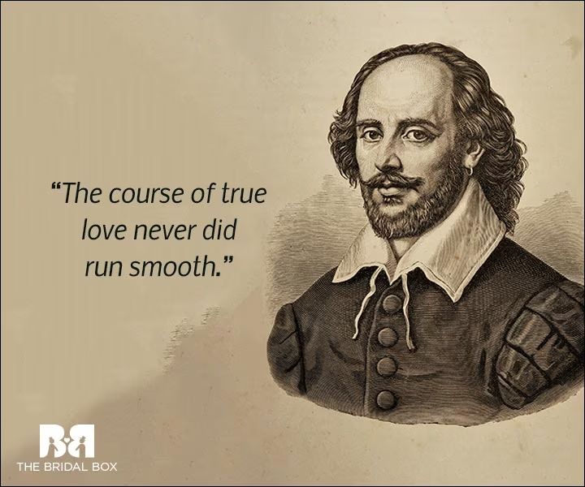
Midsummer Night’s Dream’s Message
Just like any other story, Midsummer Night’s Dream has a theme or message it answers.
One theme you can take of the story is the topic “What is Love?”
So what is William Shakespeare’s answers on the topic of What is Love?

Slide 7

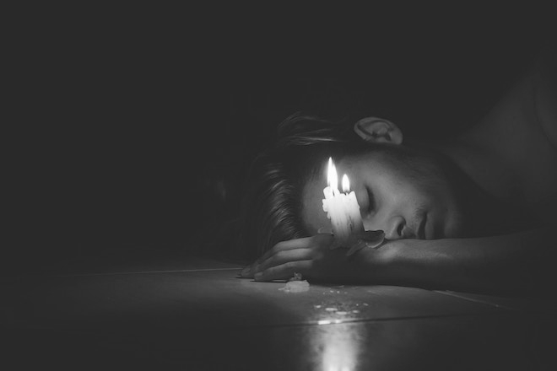
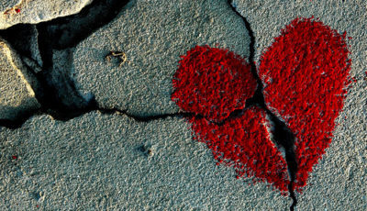
What is Love?
Love is ADDICTIVE!
Love can give someone a fate of addiction causing a painful world create by their mind falsely being pleasured.
Love is DESTRUCTIVE!
Love leads to a expected disaster that sticks out in someone’s life usually created by a mistake or intend.

Slide 8
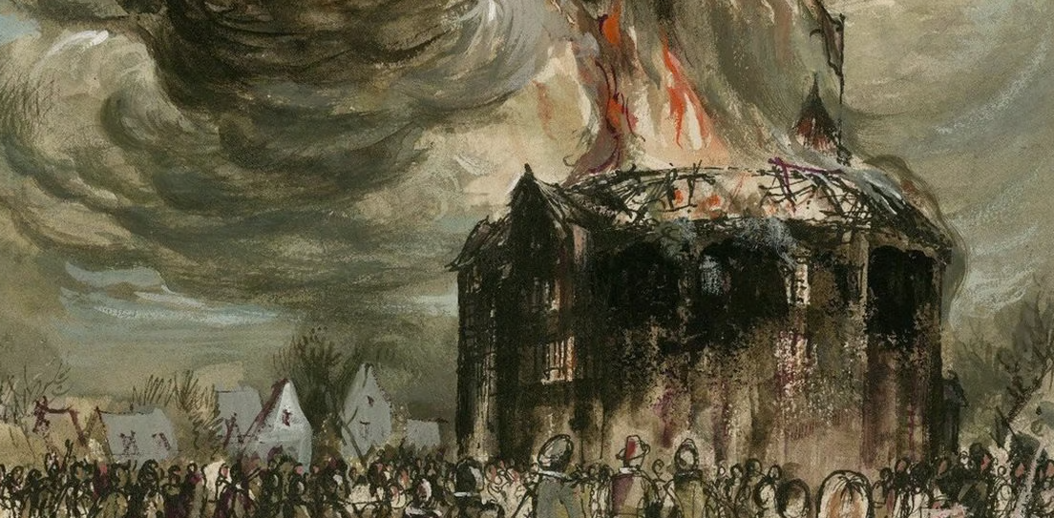
Love is DESTRUCTIVE!

Slide 9
Love is DESTRUCTIVE!
Using Quotes from A Midsummer Night’s Dream
Demetrius
Lysander.
Hermia.
“(But by some power it is) my love to Hermia,
Melted as the snow, seems to me now” (125)
“In Hermia’s love I yield you up my part.
And yours of Helena to me bequeath,
Whom I do love and will do till my death” (89)
“I amazed at your words.
I scorn you not. It seems that you scorn me.” (93)
Demetrius.
Bottom.
Oberon.
“You are too officious
Let her alone. Speak not of Helena.
Take not her part. For if thou dost intend Never so little show love of her,” (101)
“And yet, to say the truth, reason and love keep little company together nowadays.” (73)
“And think no more of this night’s accidents
But as the fierce vexation of a dream.” (117)

Slide 10

Love is DESTRUCTIVE
A Midsummer Night’s perspective of life is destructive, many character’s love is destroyed like Demetrius or Lysander’s love of Hermia or Lysander’s love of Helena almost destroys the love of Hermia. Characters like Bottom or Oberon suggested that love could cause disasters of accidents. The story solves by the disasters of love is calling it a dream.

Slide 11
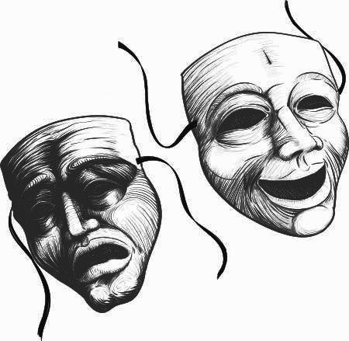
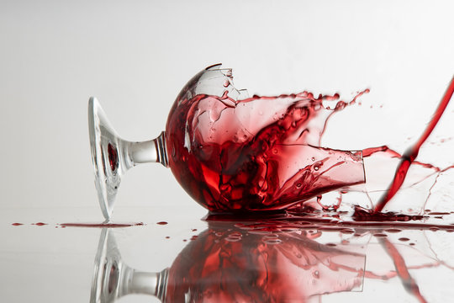
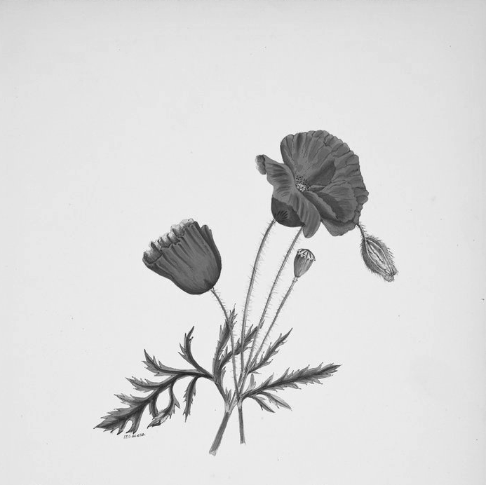
Love is ADDICTIVE!

Slide 12
Love is ADDICTIVE! Using Quotes from
A Midsummer Night’s Dream
Helena.
Robin.
“You draw me, you hard-hearted adamant!
But yet you draw not, for my heart
Is true as steel. Leave you your power to draw, And I shall have no power to follow you” (45)
“Yet but three? Come one more.
Two of both kinds makes up four.
Here she comes, curst and sad.
Cupid is a knavish lad
Thus to make poor females mad.” (109)
Demetrius.
Oberon
“To leave this city and commit to yourself
Into the hands of one that loves you not,” (45)
“Thou hast mistaken quite
And laid the love juice on some true-love’s sight.” (83)
Helena.
Robin.
“He followed you; for love, I followed him.
But he hath chid me hence and threaten me
To strike me, spurn me, nay, to kill me too.” (99)
“Jack shall have Jill;
Naught shall go ill;
The man shall have his mare again and all shall be well”(111)

Slide 13
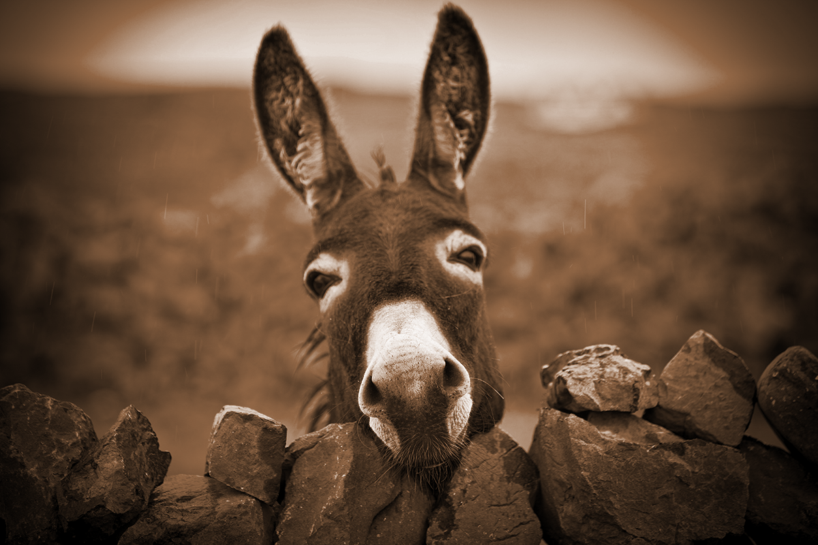
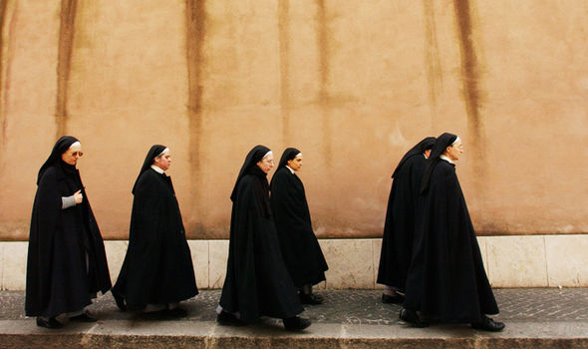

Love is ADDICTIVE
Another perspective of love of A Midsummer Night’s is addiction. Helena has volumes of addiction of love towards Demetrius. Robin suggested that lovers being addicted to the wrong lover can be unwell. Most importantly the story involves the flower that causes love addictions, it is used on both Demetrius and Lysander causing them to be heavily addictive towards Helena.

Slide 14

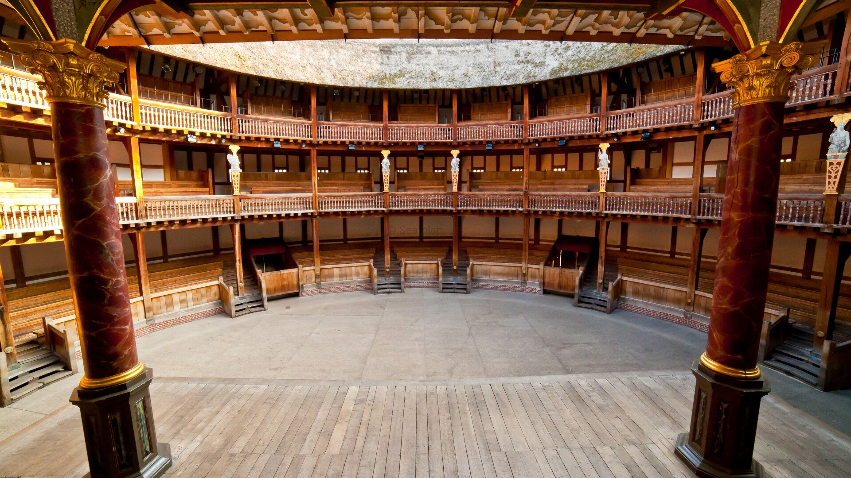
A Midsummer Night's Dream’s
Message
William Shakespeare’s A Midsummer Night’s Dream is all about the craziness of love showing many sides. It expresses the destruction it can cause and the addictive effects it brings towards people.

Slide 15
Credits
Special thanks to all the people who made and released these awesome resources for free:
Source
Literature Connects,
A Midsummer Night’s Dream
William Shakespeare and Related Readings
McDougal Littell
A Houghton Mifflin Company
Evanston Illinois
Boston
Dallas
Presentation template by SlidesCarnival
This presentation template uses the following free fonts:
Gotu and Lato
Photography
Stock Photos
WIlliam Shakespeare photos
Globe Photo
A Midsummer Night’s Dream photo

